Slide 1

Generative AI-Based Chatbot for Employee and Customer Support Automation in LOLC Company
RP25-036

Slide 2

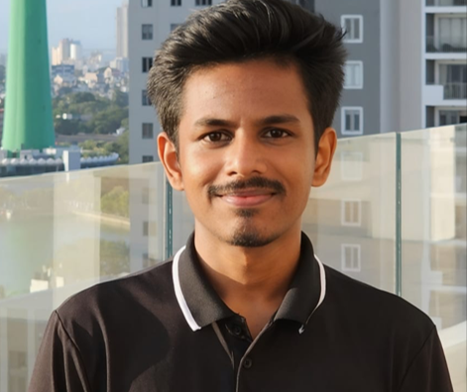




Our Team
Lakshan S.N
Gamage U.R
Fernando W.S.N
Kuruppu K.A.V.U
IT21800900
IT21807480
IT21809224
IT21315282
Prof. Nuwan Kodagoda
Dr Lakmini Abeywardhana

Slide 3
Introduction
  We are working on a research project for the LOLC Company part of a real-world initiative.
  We are planning to integrate a generative AI chatbot into their existing system based on their requirements.

Slide 4



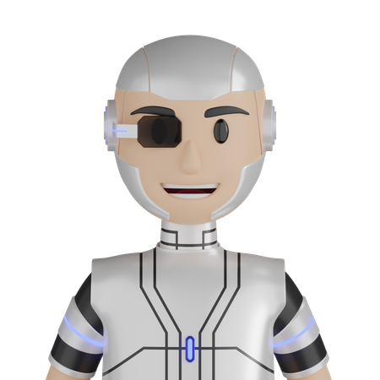
OBJECTIVES
SUB OBJECTIVE
MAIN OBJECTIVE
Multi-Agent System
Streamlined Internal communication, reduced time spent on routine queries, and improved employee productivity
Knowledgebase
Integration with forms
3D Avatar

Slide 5

Research Question
  How do we maintain an efficient memory while reducing costs and managing a knowledge base?
  How can we provide personalize responses to use employees?
  How can we implement multi-agent systems to withstand hallucinations and deliver accurate answers?
  How can the productivity of employees at LOLC Company be improved?
  How can the form-filling process be automated to reduce manual effort and increase form-filling speed through user conversations?

Slide 6
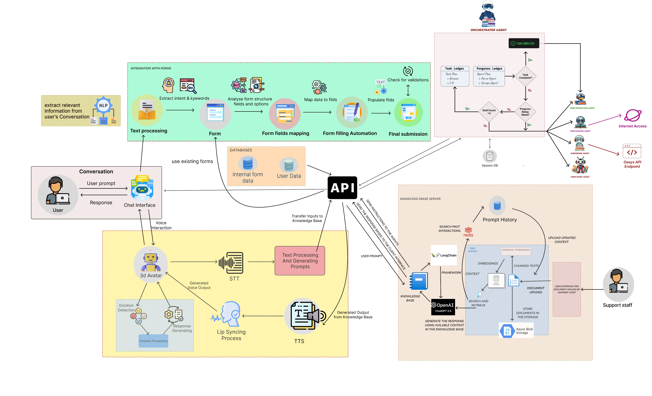
SYSTEM DIAGRAM

Slide 7
IT21800900 | LAKSHAN S.N.
Software Engineering
IT21800900 | LAKSHAN S.N. | R25-036

Slide 8



INTRODUCTION
Multi-Agentic System For dynamic Form Parsing and User Collaboration
IT21800900 | Lakshan S.N. | R25-036

Slide 9

Background
How agents Collaborate Efficiently?
How To Integrate To Existing Forms?
How To Involve User With This?
IT21800900 | LAKSHAN S.N. | R25-036

Slide 10

RESEARCH PROBLEM
"How the Agentic System Prevents Hallucinations and Clearly Recognizes User Intent"
“How agents identify and clarify the doubts that arise during processing.”
“How Agents Recognize Form Data Validation Accurately Using the Given Context”
IT21800900 | LAKSHAN S.N. | R25-036

Slide 11
RESEARCH GAP
App Agent
OPEx
Gorilla MAS
Proposed System
Specific Backend System
Prior Knowledge Integration
Agentic Web Navigation
Multi- Agent Orchestrator
Agent Communication with the User
Dynamic Form Parsing Agent
IT21800900 | LAKSHAN S.N. | R25-036

Slide 12
Objectives
Provide Intelligent and autonomous Form Submission Based On User request
An agent For Communicating With the Employee and Confirm the Submission
An Agent For Dynamic Form Parsing and Form Validation Processing
Industrial Backend System with Proper LLM Integration
IT21800900 | LAKSHAN S.N. | R25-036

Slide 13
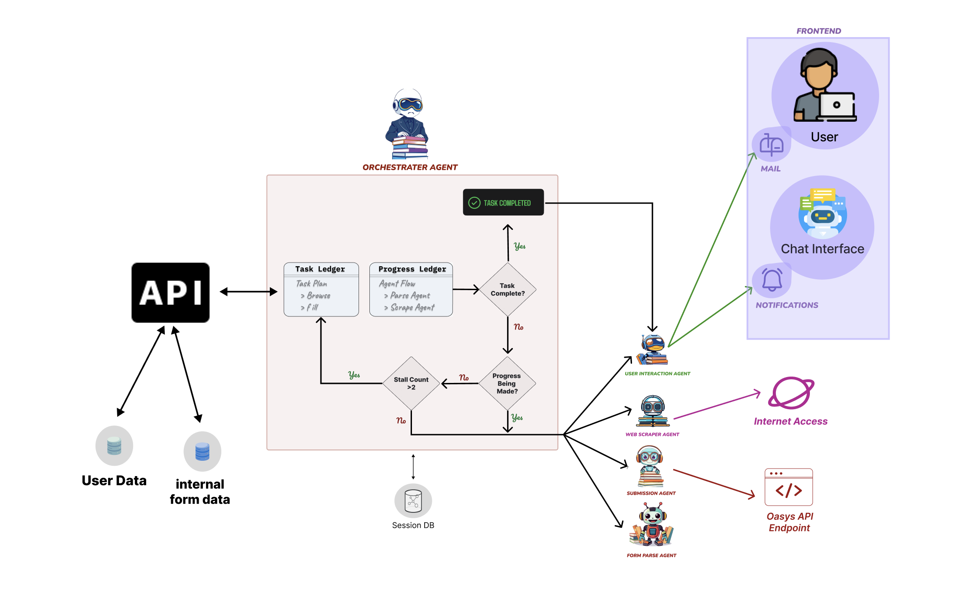
System Diagram
IT21800900 | LAKSHAN S.N. | R25-036

Slide 14
Technologies & Tools
Autogen
OpenAI API
Mongodb
Redis
Flask
Docker
Kubernetes
IT21800900 | LAKSHAN S.N. | R25-036

Slide 15
Functional Requirements
All users must be properly authenticated and validated.
Users must be notified and appropriately acknowledged for the automated response.
The system must be tested thoroughly and properly.
The system must accurately reflect the user's intentions.
IT21800900 | LAKSHAN S.N. | R25-036

Slide 16
Non Functional Requirements
Protecting all sensitive data is essential and must be prioritized without exception.
The system must be capable of both horizontal and vertical scalability.
All API endpoints must be encrypted and adhere to industry security standards.
Internet access for agents must be strictly restricted and properly filtered.
IT21800900 | LAKSHAN S.N. | R25-036

Slide 17
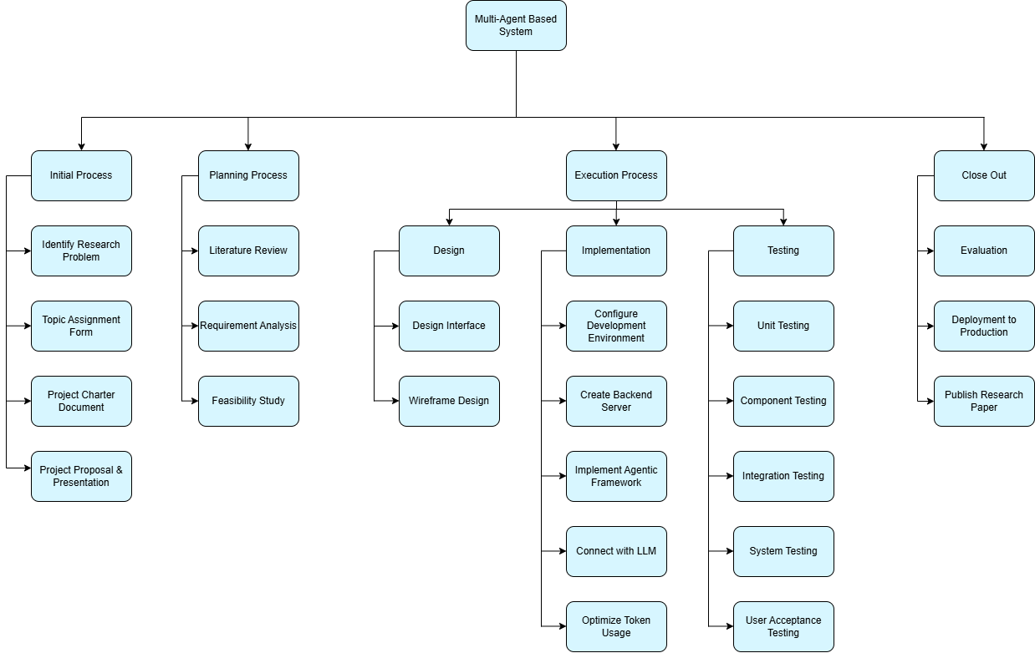
WORK BREAKDOWN STRUCTURE
IT21800900 | LAKSHAN S.N. | R25-036

Slide 18
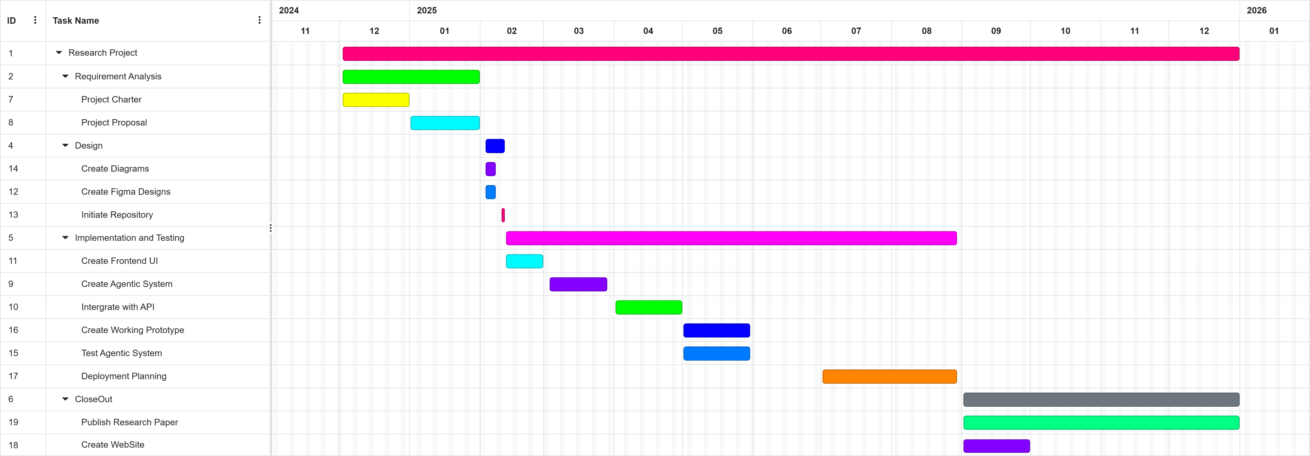
GANTT CHART
IT21800900 | LAKSHAN S.N. | R25-036

Slide 19
Reference
[1] C. Zhang et al., “AppAgent: Multimodal Agents as Smartphone Users,” arXiv.org, Dec. 21, 2023. https://arxiv.org/abs/2312.13771
[2]H. Shi, Z. Sun, X. Yuan, M.-A. Côté, and B. Liu, “OPEx: A Component-Wise Analysis of LLM-Centric Agents in Embodied Instruction Following,” arXiv.org, 2024. https://arxiv.org/abs/2403.03017 (accessed Jan. 26, 2025).
[3] S. G. Patil, T. Zhang, X. Wang, and J. E. Gonzalez, “Gorilla: Large Language Model Connected with Massive APIs,” arXiv.org, May 24, 2023. https://arxiv.org/abs/2305.15334
[4] Helen Toner, John Bansemer, Kyle Crichton and Matt Burtell, "Through the Chat Window and Into the Real World," vol. 1, 2025.
IT21800900 | LAKSHAN S.N. | R25-036

Slide 20
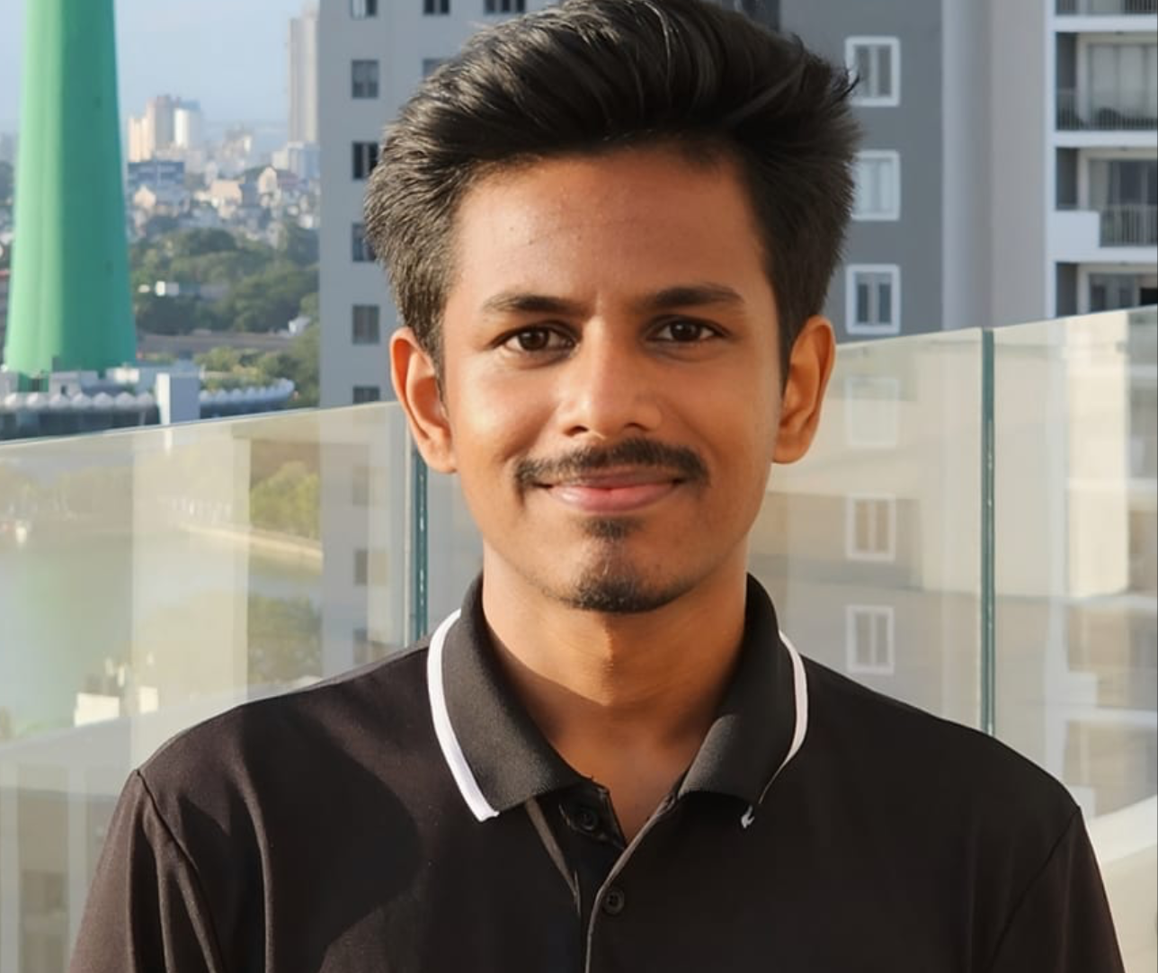
IT21807480 | Gamage U.R
Software Engineering
IT21807480 | Gamage U.R | R25-036

Slide 21

INTRODUCTION
Knowledge Base Development
IT21807480 | Gamage U.R | R25-036

Slide 22
Background
What is knowledge base ?
Dynamic Rag system ?
What is episodic memory how does it help ?
IT21807480 | Gamage U.R | R25-036

Slide 23
Research Problem
LLM - Hallucinated or irrelevant responses by LLMs
RAG - Lack of personalization and efficient memory management
RAG - Difficulty managing RAG systems and processing knowledge bases in vector databases
DOCUMENTS - Challenges in handling domain-specific data, unwanted data, and duplication
IT21807480 | Gamage U.R | R25-036

Slide 24
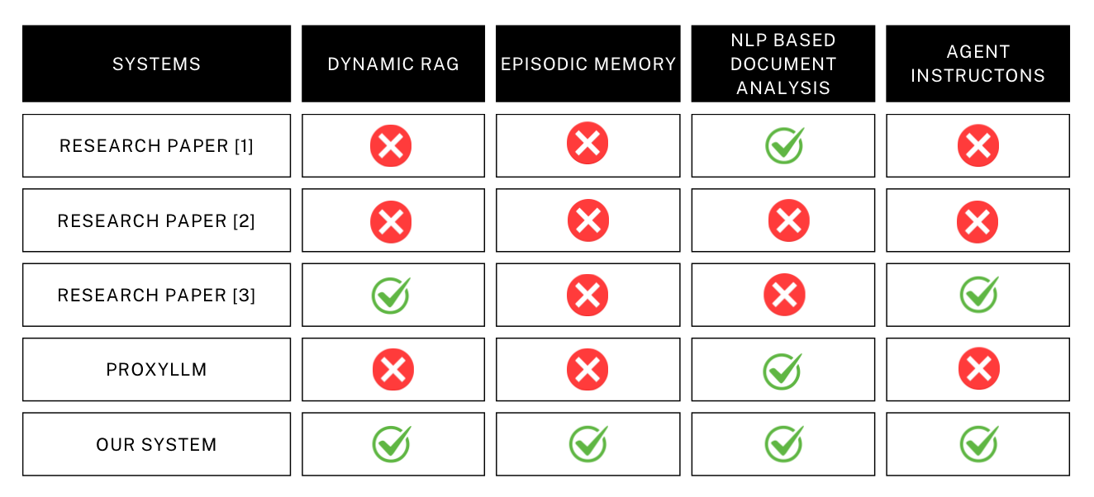
Research Gap
IT21807480 | Gamage U.R | R25-036

Slide 25
Objectives
Domain specific Knowledge base development (IT support, HR policies, Business process)
Develop a dynamic RAG(Retrieval-argument-generation) system.
Implement an episodic memory framework to generate personalized responses based on user feedback, and update the database.
Design and develop a user-friendly UI interface with an NLP-based document content identification and categorization system.
IT21807480 | Gamage U.R | R25-036

Slide 26
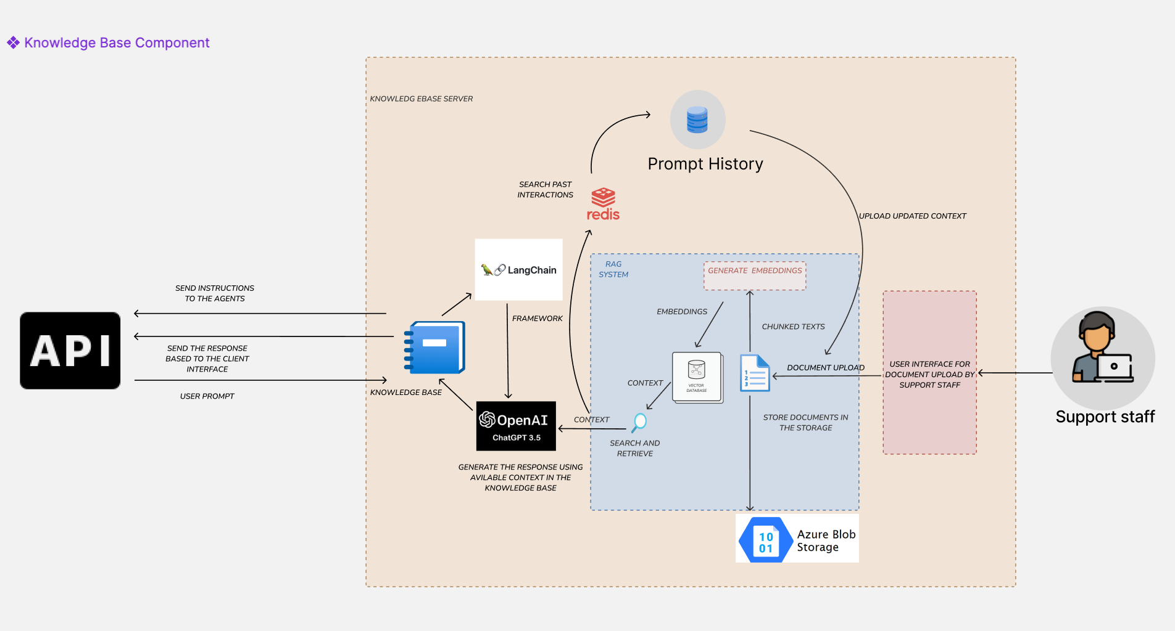
System Diagram
IT21807480 | Gamage U.R | R25-036

Slide 27
Technologies & Tools
OpenAI API
Mongodb
Docling
ChromaDB
Redis
Flask
Huggingface
Langchain
Docker
Azure Cloud Technologies
IT21807480 | Gamage U.R | R25-036

Slide 28
Functional Requirements
Provide personalise domain specific answers based on avilable context for the users queries
Provide step-by-step suggestions to resolve queries.
Dynamic knowledge base management
Agent instruction generation
IT21807480 | Gamage U.R | R25-036

Slide 29
Non-functional requirements
Preformance - should be able to provide faster response
Scalability - knowledgebase should have the scalability to
Security - should protect the internal data and use encryption to ensure the data security
Acessbility – should be able to access the system from different LOLC branches
IT21807480 | Gamage U.R | R25-036

Slide 30
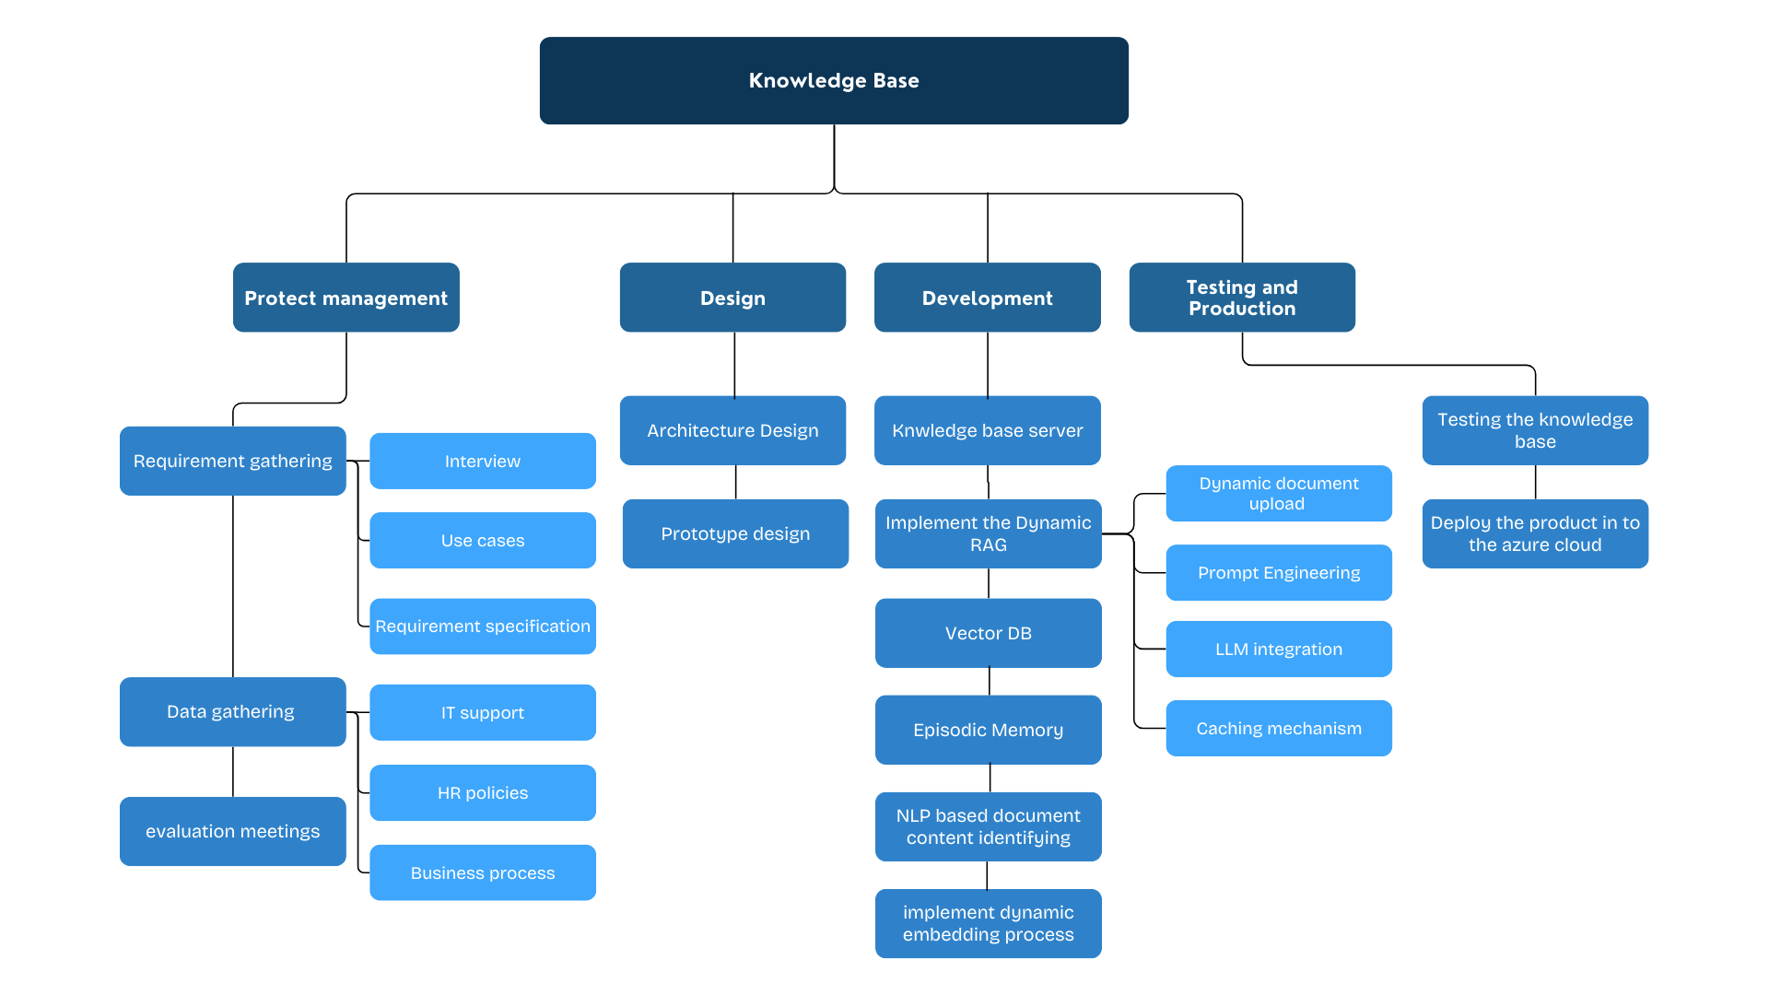
WORK BREAKDOWN STRUCTURE
IT21807480 | Gamage U.R | R25-036

Slide 31
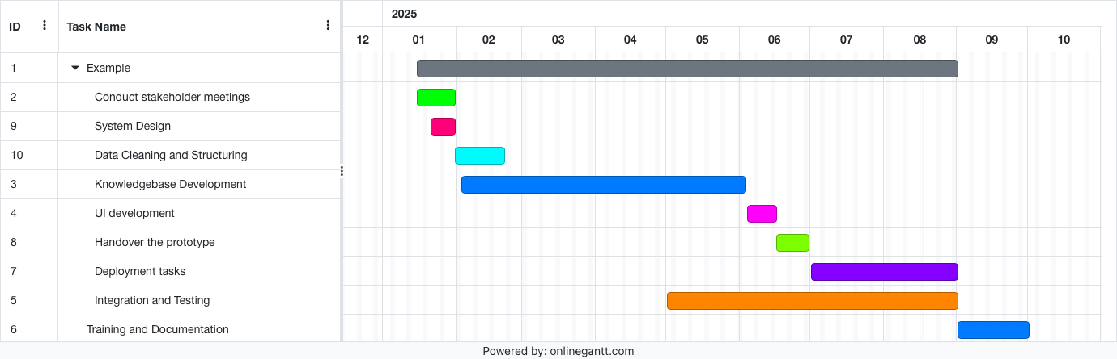
GANTT CHART
IT21807480 | Gamage U.R | R25-036

Slide 32
Reference
[1] Jeong, Cheonsu. "A Study on the Implementation Method of an Agent-Based Advanced
RAG System Using Graph." arXiv preprint arXiv:2407.19994 (2024).
[2] Zhao, Shengming, et al. "Towards understanding retrieval accuracy and prompt quality in
RAG systems." arXiv preprint arXiv:2411.19463 (2024).
[3] Oluwagbade, Elizabeth. "Conversational AI as the New Employee Liaison: LLM-
Powered Chatbots in Enhancing Workplace Collaboration and Inclusion." (2024).
[4] ProxyLLM : LLM-Driven Framework for Customer Support Through Text-Style Transfer
[5] Finsås, Mats, and Joachim Maksim. Optimizing RAG Systems for Technical Support
with LLM-based Relevance Feedback and Multi-Agent Patterns. MS thesis. NTNU, 2024
[6] Cederlund, Oscar, Sadi Alawadi, and Feras M. Awaysheh. "LLMRAG: An Optimized
Digital Support Service using LLM and Retrieval-Augmented Generation." 2024 9th
International Conference on Fog and Mobile Edge Computing (FMEC). IEEE, 2024.
IT21807480 | Gamage U.R | R25-036

Slide 33
IT21315282 | Kuruppu K.A.V.U
Software Engineering
IT21315282 | Kuruppu K.A.V.U | R25-036

Slide 34

INTRODUCTION
INTEGRATION WITH FORMS
IT21315282 | Kuruppu K.A.V.U | R25-036

Slide 35

RESEARCH PROBLEM
Abandon Form Because of the Following Reasons:
  Complexity
  Time-consuming nature
  Lack of knowledge about relevant information needed to complete the form
IT21315282 | Kuruppu K.A.V.U | R25-036

Slide 36

OBJECTIVES
Chat UI Design.
Filling the Form Based on a Conversation.
Extract Relevant Information (Intent and Keywords).
Analyze the Form Fields and Structure.
Populate the Form Fields and Automate Form Filling.
Validation Process.
IT21315282 | Kuruppu K.A.V.U | R25-036

Slide 37
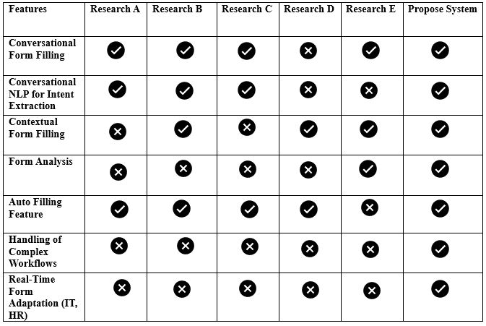
RESEARCH GAP
IT21315282 | Kuruppu K.A.V.U | R25-036

Slide 38
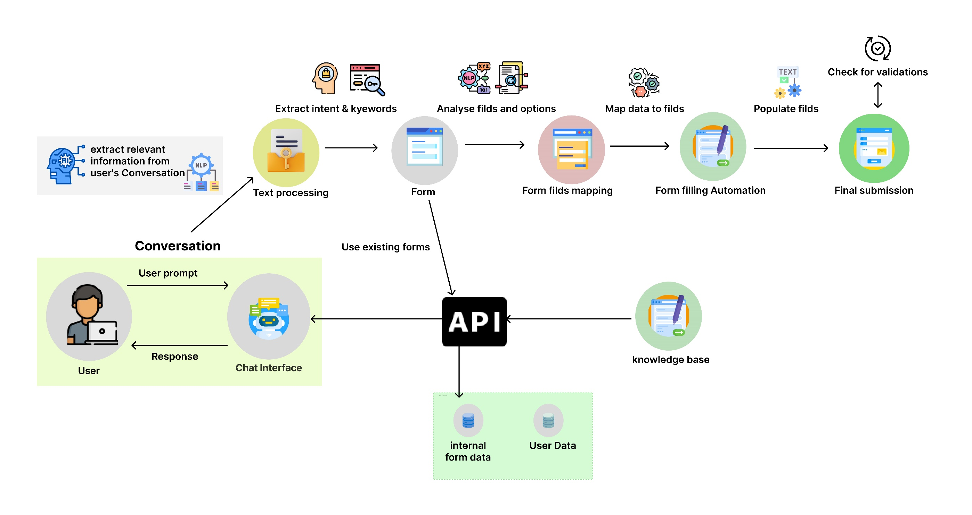
METHODOLOGY SYSTEM DIAGRAM
IT21315282 | Kuruppu K.A.V.U | R25-036

Slide 39
TECHNOLOGIES
Natural Language Processing Models (BERT or spaCy)
Form Filling Automation ( Selenium or Puppeteer or BeautifullSoupUI )
Python flask
TensorFlow
Docker
IT21315282 | Kuruppu K.A.V.U | R25-036

Slide 40
FUNCTIONAL & NON-FUNCTIONAL REQUIREMENT
Functional
  Filling Forms using user conversation.
  Extract Intent and Keywords from User Conversations.
  Form Understanding and Analysis.
  Automate Form Filling.
  Validation Process.
Non-Functional
  Performance
  Responsiveness
  Accuracy
  Reliability
  Adaptability
  Scalability
IT21315282 | Kuruppu K.A.V.U | R25-036

Slide 41
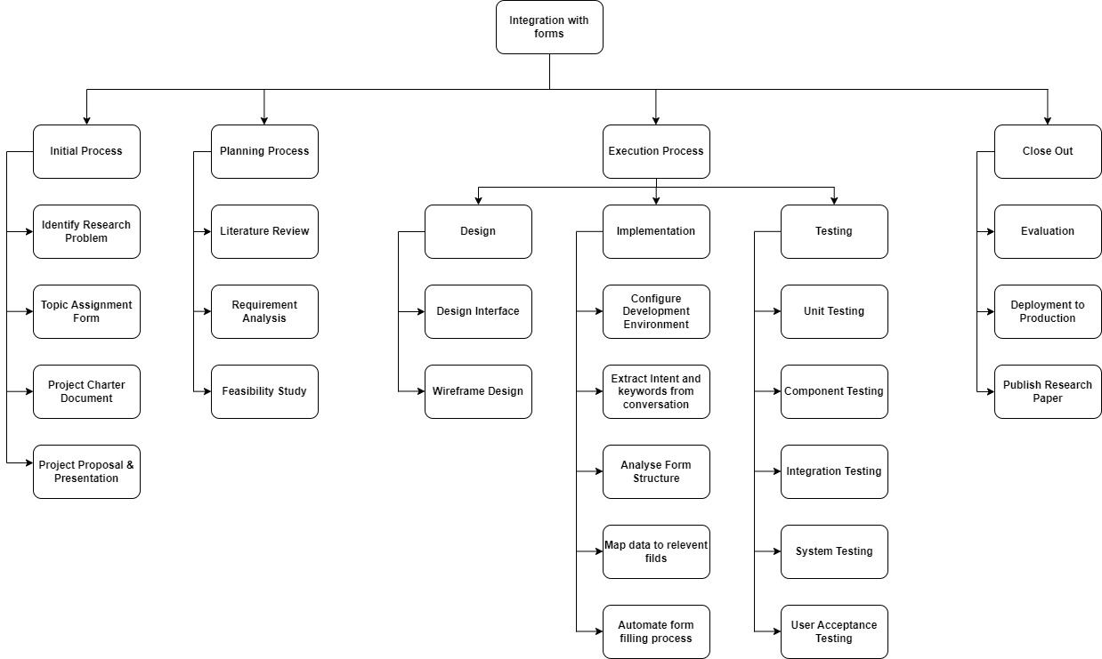
WORK BREAKDOWN STRUCTURE
IT21315282 | Kuruppu K.A.V.U | R25-036

Slide 42
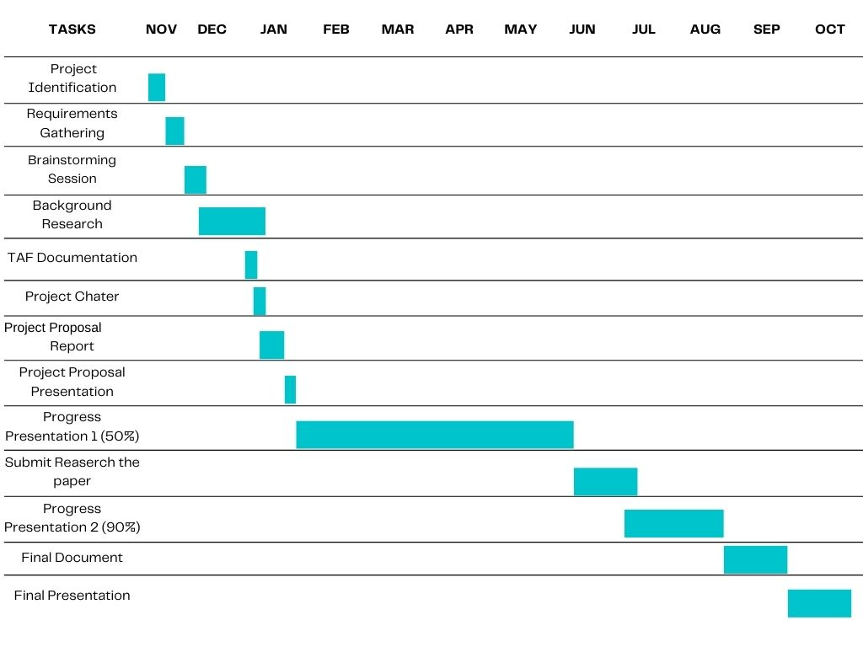
GANTT CHART
IT21315282 | Kuruppu K.A.V.U | R25-036

Slide 43
REFERENCES
[1] Saberion, "OASYS," LOLC Technologies, [Online]. Available: https://lolc.oasys.lk. [Accessed january 2025].
[2] E. Rukzio, "Automatic form filling on mobile devices," Pervasive and Mobile Computing, vol. 4, no. 2, p. 161–181, 2008.
[3] H. Belgacem, "A Machine Learning Approach for Automated Filling of Categorical Fields in Data Entry Forms," ACM Transactions on Software Engineering and Methodology, vol. 32, no. 2, pp. 1-40, 2023.
[4] A. V. Bataev, "The role of automation in improving the quality of enterprise business processes," IOP Conference Series Materials Science and Engineering, 2020.
[5] M. Bucur, "Exploring large language models and retrieval augmented generation for automated form filling," University of Twente, Enschede, 2023.
[6] A. R. Hegde, "Automated government form filling for aged and monolingual people using interactive tool", Disability and Rehabilitation: Assistive Technology, Vols. vol. 19, no. 61, pp. 1-11, 2023.
[7] D. Patil, "Bot form filler," International Journal of Research Publication and Reviews, vol. 4, no. 10, pp. 1-3, 2023.
IT21315282 | Kuruppu K.A.V.U | R25-036

Slide 44
REFERENCES
[8] S. Wang, Y. Zou, I. Keivanloo, B. Upahyaya and J. Ng, "An intelligent framework for auto-filling web forms from different web applications," International Journal of Business Process Integration and Management, vol. 8, no. 1, p. 16, 2017.
[9] W. Metellus , S. Balireddi, M. Maelzer, M. Ganaba and E. Shiroma, "Artificial Intelligence Agent for Contextual Guidance in Form Filling," 20 2024 2024. [Online]. Available: https://www.tdcommons.org/dpubs_series/7575. [Accessed january 2025].
[10] J. Ellery, "Avoiding common mistakes on grant applications," Headteacher Update, vol. 6, p. 98917, 2013.
[11] J. Ellery, "Get that funding – avoiding common grant application mistakes," SecEd, vol. 2013, p. 1783, 2013.
[12] "6 Steps for avoiding online form abandonment," 2018. [Online]. Available: https://themanifest.com/web-design/blog/6-steps-avoid-online-form-abandonment.
[13] P. Viola and M. Narasimhan, "Learning to extract information from semi-structured text using a discriminative context free grammar," in IGIR '05: Proceedings of the 28th Annual International ACM SIGIR Conference on Research and Development in Information Retrieval, Salvador, Brazil, 2005.
IT21315282 | Kuruppu K.A.V.U | R25-036

Slide 45

IT21809224 | Fernando W. S. N.
Software Engineering
IT21809224 | Fernando W. S. N.| R25-036

Slide 46

Introduction
3D Avatar Chatbot with Emotion Processing
IT21809224 | Fernando W. S. N.| R25-036

Slide 47
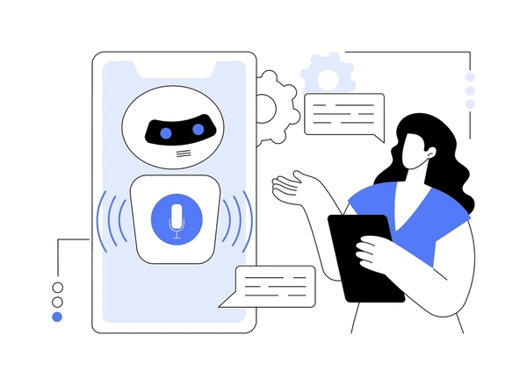
Background
This project introduces a 3D avatar chatbot that combines real-time emotion detection, sentiment analysis, and STT/TTS technologies to deliver personalized, context-aware responses. Featuring a lifelike avatar with synchronized expressions and gestures, it creates more engaging and human-like interactions compared to traditional chatbots.
This innovation enhances virtual communication by integrating emotional intelligence with 3D visual interactions, offering personalized and immersive experiences. It has potential applications in healthcare, education, and customer support.
IT21809224 | Fernando W. S. N.| R25-036

Slide 48

Research Problem
Traditional chatbots lack emotional intelligence.
They fail to provide visual engagement and lifelike animations.
Conventional systems are not adaptable to user emotions.
Limited capability to deliver meaningful and engaging interactions.
Inability to bridge the gap between human and virtual communication.
IT21809224 | Fernando W. S. N.| R25-036

Slide 49
Research Gap
Features | Research [1] | Research [2] | Research [3] | Proposed Solution
Real-Time Emotion Detection | ✅ | ❌ | ✅ | ✅
Adaptive Interactions Based on Emotion | ❌ | ❌ | ❌ | ✅
Integration of 3D Avatars for Realism | ❌ | ✅ | ❌ | ✅
Lip-Syncing and Gesture Synchronization | ❌ | ❌ | ✅ | ✅
Personalized User Experiences | ❌ | ❌ | ❌ | ✅
IT21809224 | Fernando W. S. N.| R25-036

Slide 50

Objectives
Main Objective :
  To design and implement a 3D avatar chatbot capable of real-time emotion detection and adaptive interactions to enhance user engagement and communication.
Sub Objectives :
  Develop Real-Time Emotion Processing.
  Design a 3D Avatar Framework.
  Personalize User Experiences.
  Use Text-to-Speech (TTS) and Speech-to-Text (STT) Modules
IT21809224 | Fernando W. S. N.| R25-036

Slide 51
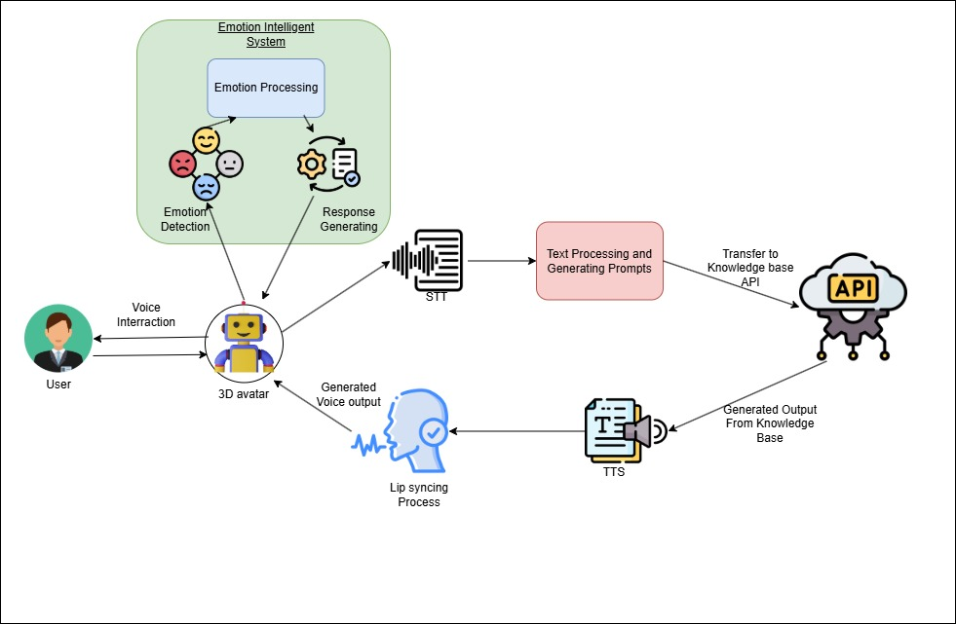
Methodology & System Diagram
IT21809224 | Fernando W. S. N.| R25-036

Slide 52
Technologies & Techniques
3D Modelling and Animation Tools
  Blender, Unity, or Unreal Engine (for creating the 3D avatar).
Programming Languages
  Python, JavaScript (for integrating backend logic and APIs).
Speech Processing Frameworks
  Google Cloud Speech-to-Text, IBM Watson, or Amazon Polly (for TTS and STT).
AI and ML Frameworks
  TensorFlow, PyTorch (for emotion detection and sentiment analysis).
Backend and Database
  Node.js, Flask/Django (backend); MongoDB, MySQL (database).
IT21809224 | Fernando W. S. N.| R25-036

Slide 53
Requirements
Functional Requirements
  Real-time emotion detection.
  User interaction via text and voice.
  3D avatar with adaptive behaviour.
  Speech-to-Text (STT) and Text-to-Speech (TTS).
  Accurate knowledge base retrieval.
Non- Functional Requirements
  Quick response time.
  Secure and encrypted data handling.
  High availability.
  Scalable for multiple users.
IT21809224 | Fernando W. S. N.| R25-036

Slide 54
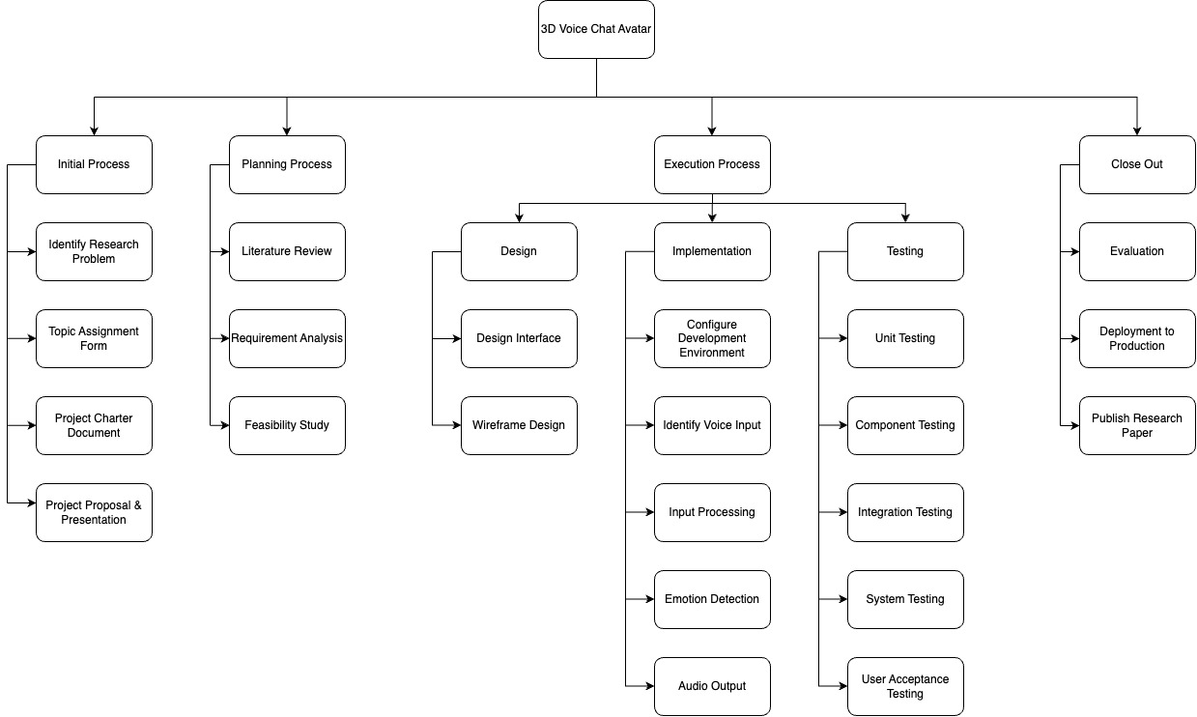
Completion of the Project
IT21809224 | Fernando W. S. N.| R25-036

Slide 55
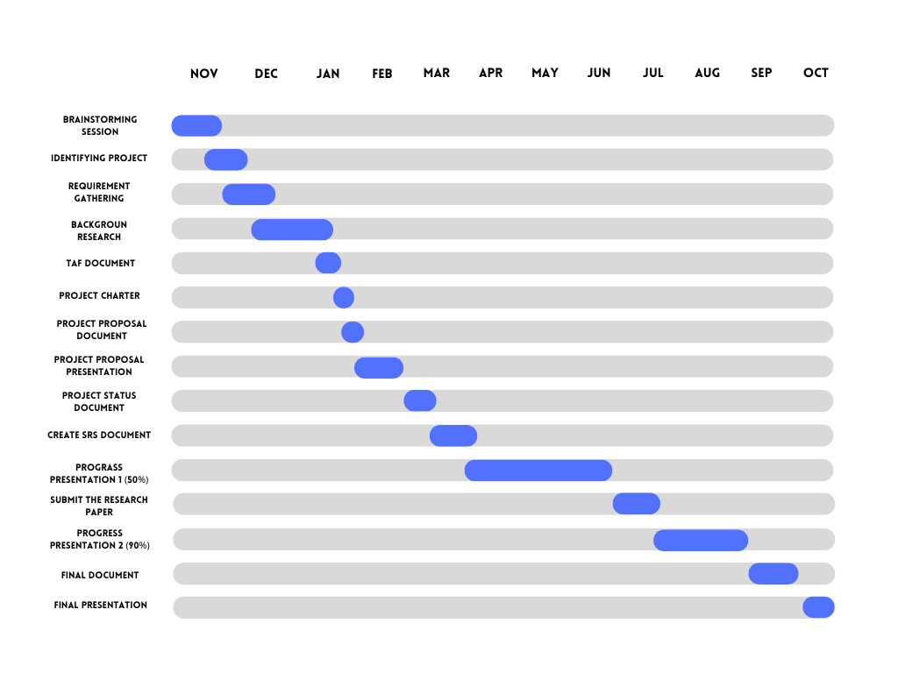
Gantt Chart
IT21809224 | Fernando W. S. N.| R25-036

Slide 56
Reference
[1] Angga, P. A., & Fachri, M. (2015). This paper proposes a design of a chatbot with an avatar and voice interaction to make conversations more lively.
  https://www.researchgate.net/publication/304409195_Design_of_chatbot_with_3D_avatar_voice_interface_and_facial_expression
[2] Kumar, S., & Sharma, A. (2024). This research investigates the development of adaptive customer support chatbots that use real-time sentiment analysis to
generate contextually appropriate responses.
  https://www.researchgate.net/publication/382524835_Adaptive_Chatbots_Real-Time_Sentiment_Analysis_for_Customer_Support
[3] Lee, J., & Park, S. (2023). This paper presents a novel real-time facial feature
extraction algorithm suitable for implementing emotion recognition in 3D avatars.
  https://www.researchgate.net/publication/379125003_The_emotional_metaverse_exploring_the_benefits_of_predicting_emotion_from_3D_avatars.
IT21809224 | Fernando W. S. N.| R25-036

Slide 57
[4] Patil, S., & Kulkarni, R. (2020). This model takes users' speech, detects their
emotions, and provides appropriate replies through speech, benefiting many
patients.
  https://www.warse.org/IJATCSE/static/pdf/file/ijatcse263942020.pdf?utm_source=chatgpt.com
[5] Zhang, H., & Li, M. (2023). This research introduces a multi-modal framework that integrates text, voice, and facial expression analysis to enhance emotion
recognition and response adaptability
  https://healthinformaticsjournal.com/index.php/IJMI/article/view/676?utm_source=chatgpt.com.
IT21809224 | Fernando W. S. N.| R25-036

Slide 58

Thank You

